Slide 1


Loan Amount Prediction
BRINDHALAKSHMI

Slide 2
INTRODUCTION
The primary objective is to leverage machine learning techniques to build a robust predictive model capable of accurately estimating the loan amount. By analysing historical loan data and identifying patterns, the model will learn to predict loan amounts for future applicants.

Slide 3
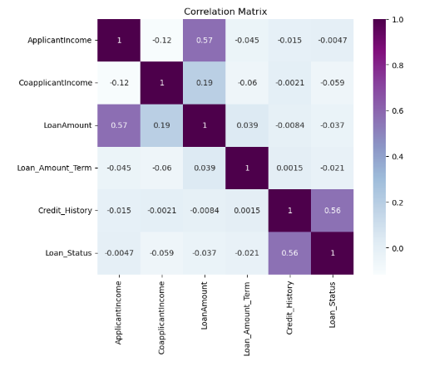
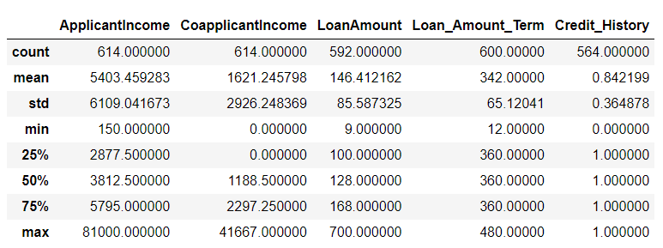
Dataset and EDA
In the project's EDA phase, we employed visualization techniques such as histograms, and correlation matrices to analyze the distribution, relationships, and correlations between numerical variables. Additionally, bar plots, count plots, and cross-tabulations were utilized to explore the frequency distribution and associations among categorical variables, providing valuable insights into the dataset's structure and informing subsequent modeling strategies.

Slide 4
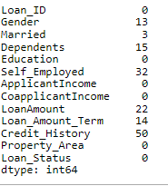
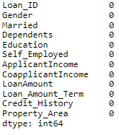
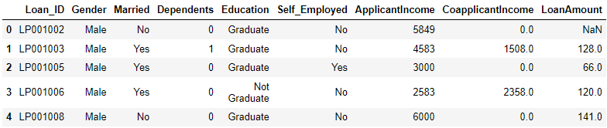
Data Preprocessing
In the preprocessing phase of this project, we addressed missing values, outliers, and categorical variables by employing techniques such as imputation, trimming. Additionally, we standardized numerical features and scaled the data to ensure uniformity and enhance model performance.

Slide 5
Predictive Modelling
In the predictive modeling phase, we trained four classification algorithms—Logistic Regression, Decision Tree, Random Forest, and XGBoost Classifier—using StratifiedKFold cross-validation to evaluate their performance. Hyperparameter tuning was performed to optimize model parameters, and model evaluation metrics such as accuracy and AUC-ROC were utilized to assess predictive performance and identify the most effective algorithm for loan prediction.
We opted for XGBoost Classifier due to its superior performance in capturing complex data patterns and achieving high accuracy through gradient boosting techniques, making it ideal for our loan prediction task. Its ability to handle intricate relationships within the data and scalability further solidified its suitability for handling large datasets commonly encountered in financial applications.

Slide 6
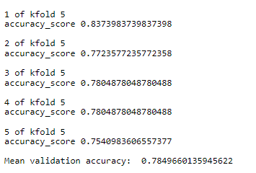
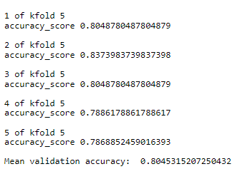
Evaluation and Results
In the evaluation phase, we assessed the performance of four classification algorithms—Logistic Regression, Decision Tree, Random Forest, and XGBoost Classifier—utilizing metrics such as accuracy, precision, recall, and F1-score. XGBoost Classifier demonstrated superior performance with the highest mean validation accuracy of 80.45%, making it the optimal choice for loan prediction tasks. Its ability to capture intricate data patterns effectively and achieve high accuracy underscores its suitability for real-world deployment in financial applications.
Random forest classification accuracy
XGBoost classification accuracy

Slide 7
Conclusion
Employing advanced machine learning techniques, including Logistic Regression, Decision Tree, Random Forest, and XGBoost Classifier, in conjunction with the StratifiedKFold method facilitated a comprehensive evaluation for loan prediction tasks. While Logistic Regression served as a robust baseline model, XGBoost Classifier emerged as the optimal choice, exhibiting superior performance in capturing complex data patterns and achieving high accuracy. This project underscores the significance of leveraging ensemble-based algorithms like XGBoost in financial applications, showcasing their ability to handle intricate data relationships effectively and enhance predictive performance.

Slide 8


Thank you

